Slide 1
Movies Analysis
Data processing steps
Key findings
Revenue categories and conclusion
EDA ( Visual Representations)
Robert Jones

Slide 2
Data Preprocessing Steps
importing a necessary libraries to work with the dataset.
importing the dataset .
checking details of Dataset using info() and describe() for basic understanding about the data.
checking is their null value in the data using "isnull().sum()" method.
checking the null value percentage using "df.null().mean() * 100)" function.
treating missing values using some basic statistics method.
checking the outliers using boxplot for datapoint understanding.
for Target Variable we can consider 'Revenue', because based on dataset, its most important.

Slide 3
Key findings
Correlation between budget and revenue
Top production companies
Runtime Analysis
Release date with Revenue Trends

Slide 4
Revenue Categories and Conclusion
Industry should be monitored continuously
Tie – up most famous Production company will lead as to the success.
High – budget productions correlate with higher revenue, but some exceptions will be there.

Slide 5
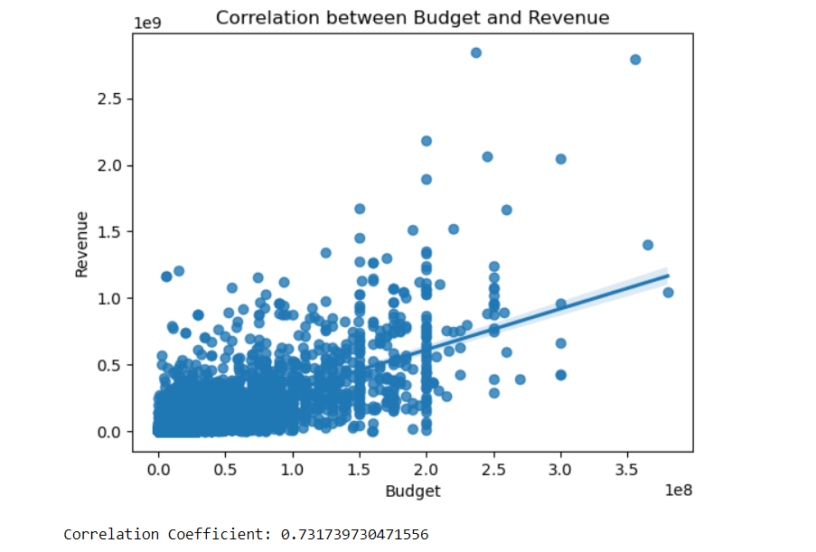
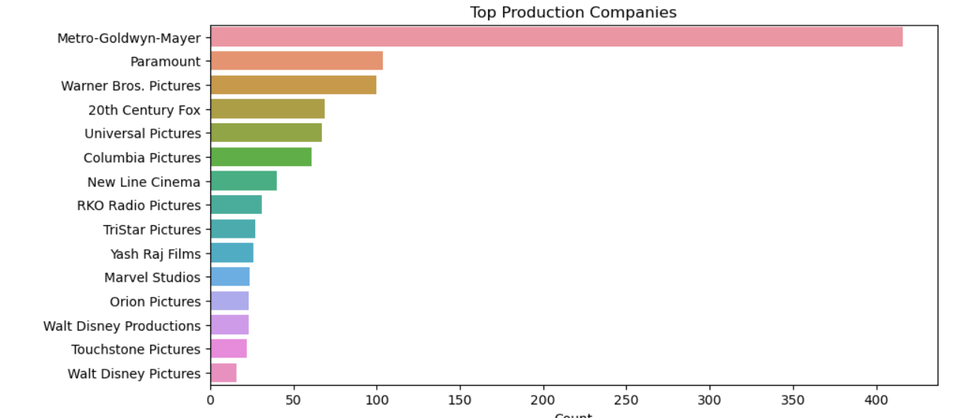
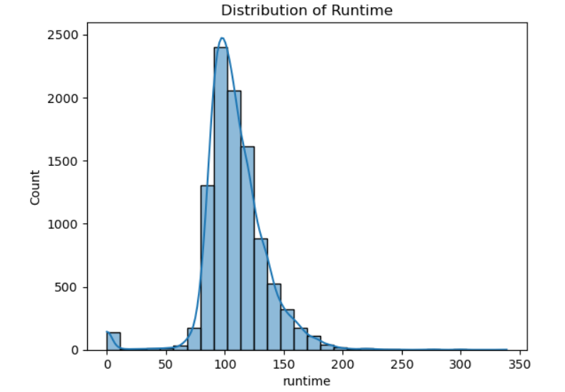
EDA ( Exploratory Data Analysis)
Detailed EDA for each variable and find the trends on it.
No of movies Release in every year
Top 15 Production companies and more

Slide 6
Thank you

